Slide 1

Northern Territory
Ian Scrimgeour
Executive Director, NT Geological Survey
APPEA, 29 May 2019
DEPARTMENT OF PRIMARY INDUSTRY AND RESOURCES

Slide 2
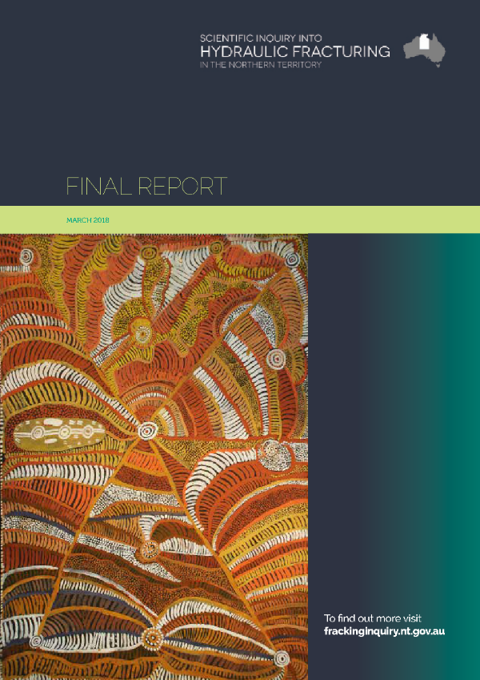
Hydraulic fracturing in the NT
Scientific Inquiry into Hydraulic Fracturing delivered final report March 2018
All 135 recommendations from Inquiry accepted & moratorium on hydraulic fracturing lifted April 2018
31 recommendations to be implemented prior to exploration recommencing – concerted effort across government to implement these
Exploration in the Beetaloo Sub-basin on track to recommence in 2019.
Information on recommendations and implementation: www.hydraulicfracturing.nt.gov.au
No acreage release planned for the NT in 2019

Slide 3
Implementation of HFI recommendations
Change to the way government and industry has operated for petroleum exploration/production in the NT.
Changes to date include:
  Amendments to Petroleum Act and associated environmental regs
  Separation of responsibilities between Environment and Resources ministers
  Removal of exemption from Water Act
  Environmental Management Plans publicly advertised
  Baseline environmental monitoring (methane, water and weeds).
  Codes of Practice
  Reserved Blocks (no go zones)
Further recommendations to be implemented before production

Slide 4
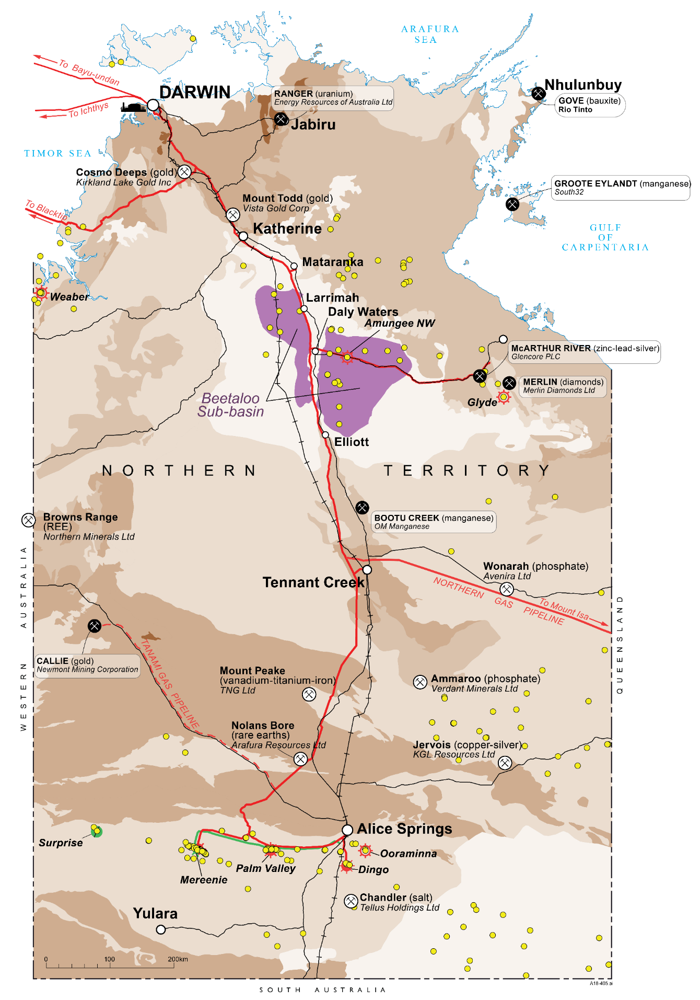
The opportunity: Beetaloo Sub-basin
30,000km², geologically continuous shale gas basin
Similar in scale and geology to US shale plays
>500 Tcf of gas in place within B-shale of Velkerri Formation
First horizontal hydraulically fractured well in 2016 successfully flowed gas
Stacked dry gas and liquids-rich plays
Drilling recommencing this dry season

Slide 5
Wells planned for 2019
BEETALOO SUB-BASIN
Santos: Tanumbirini-1/2H
Inacumba-1/1H
Horizontal wells in B-shale of Velkerri Formation
Origin Energy: Kyalla-117 N2
Testing liquids-rich gas play in Kyalla Formation, including hydraulic fracturing
Possible additional well in 2019
AMADEUS BASIN
Santos: Dukas-1
Targeting large sub-salt gas play in basal stratigraphy of Amadeus Basin

Slide 6
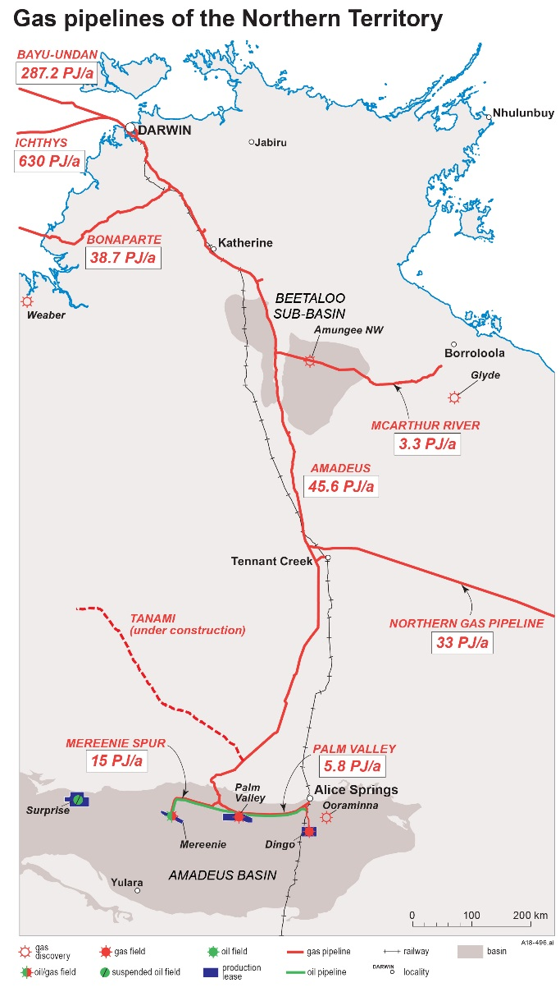
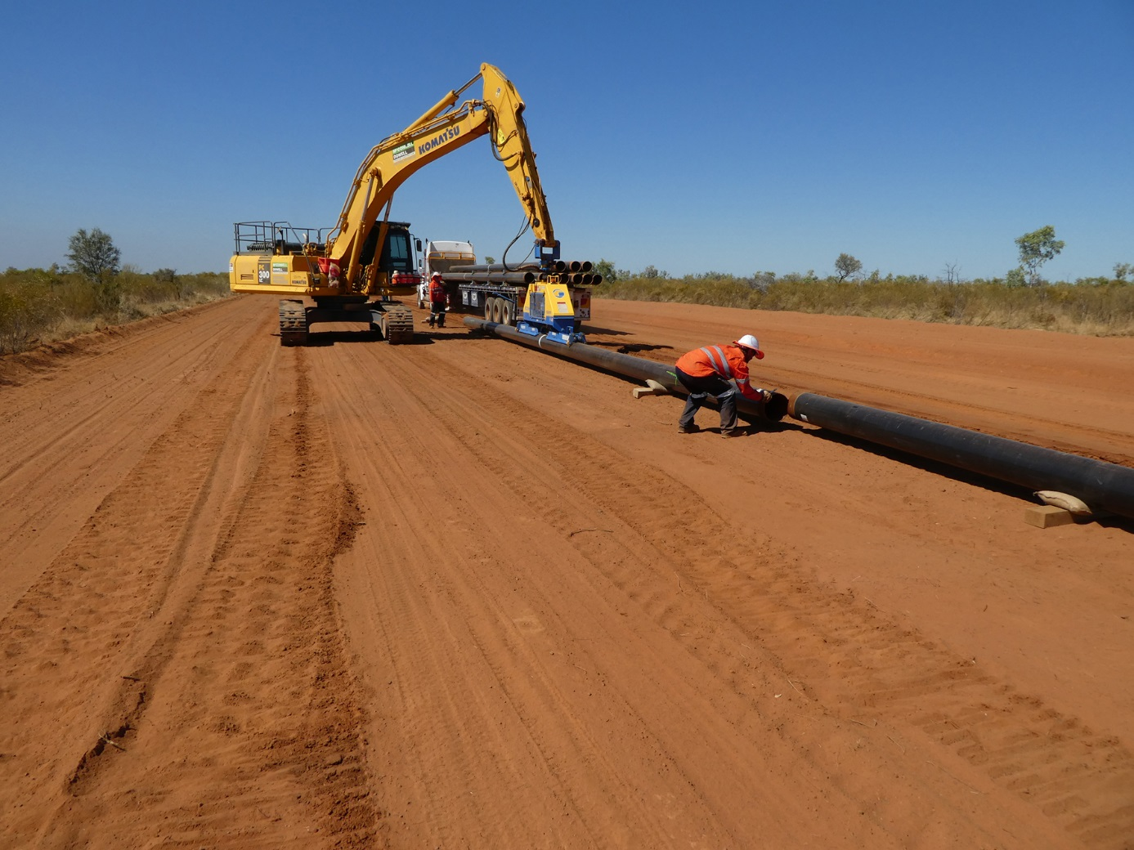
Gas Pipeline Infrastructure in the Northern Territory
Northern Gas Pipeline and Tanami Gas Pipeline now in operation

Slide 7
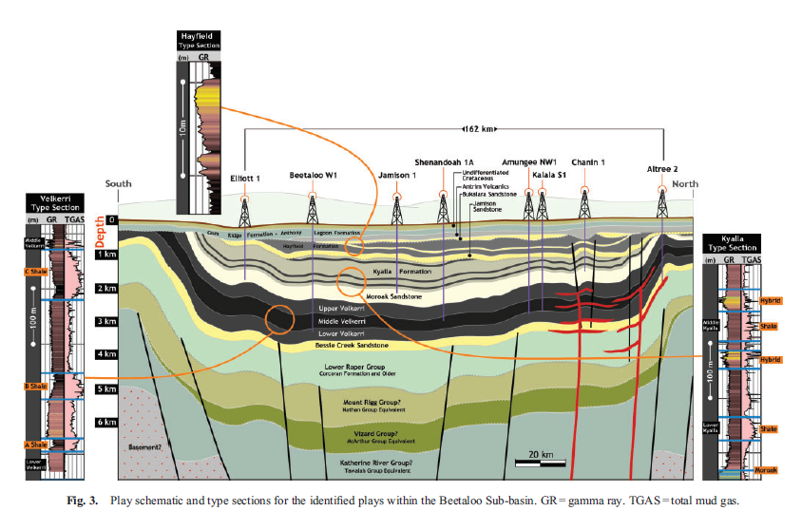
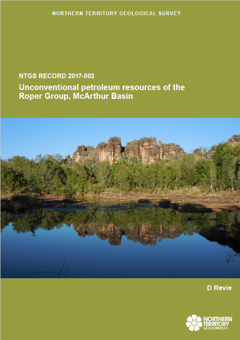
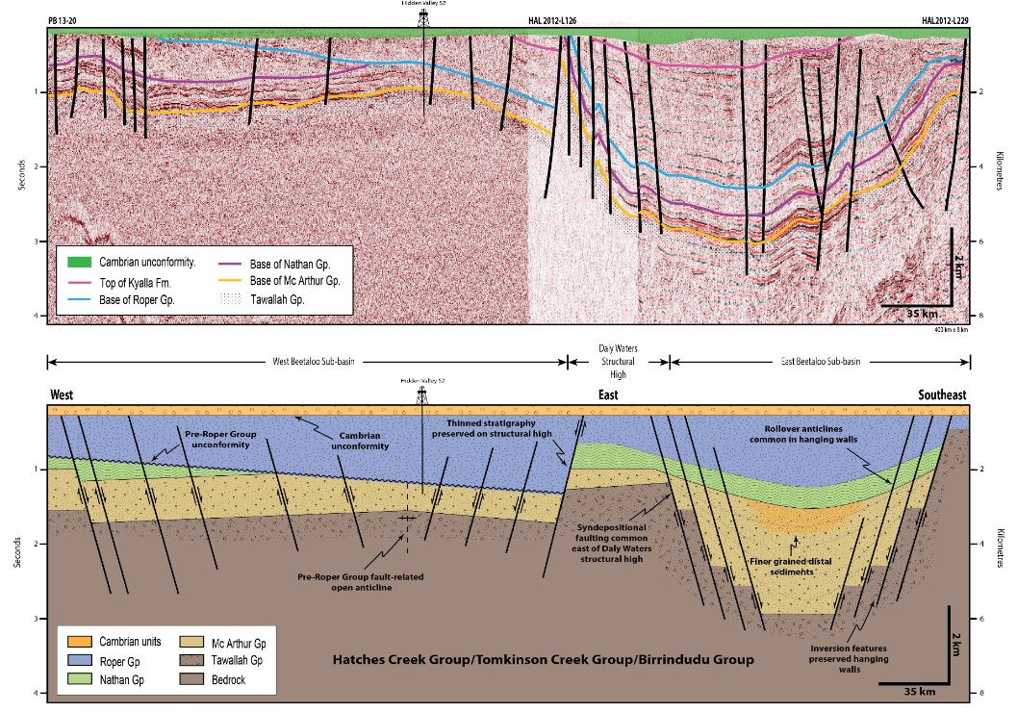
Geoscience data – Beetaloo Sub-basin
Interpretation-ready Kingdom® seismic project
Comprehensive dataset on shale chemistry and properties
Stratigraphic characterisation
Schematic E-W composite cross section through Beetaloo Sub-basin

Slide 8
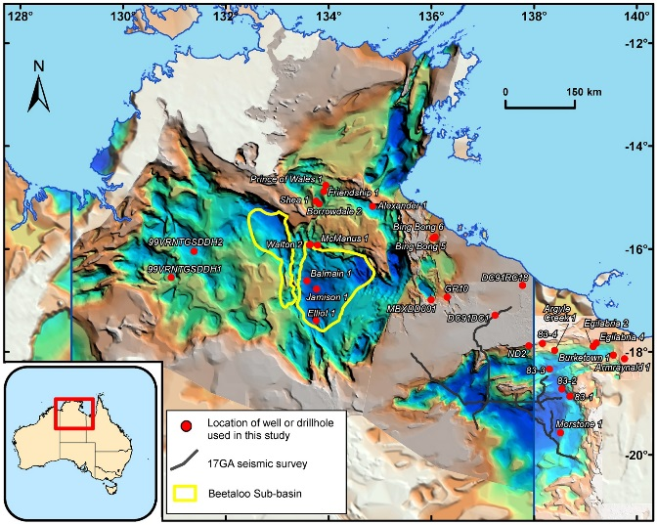
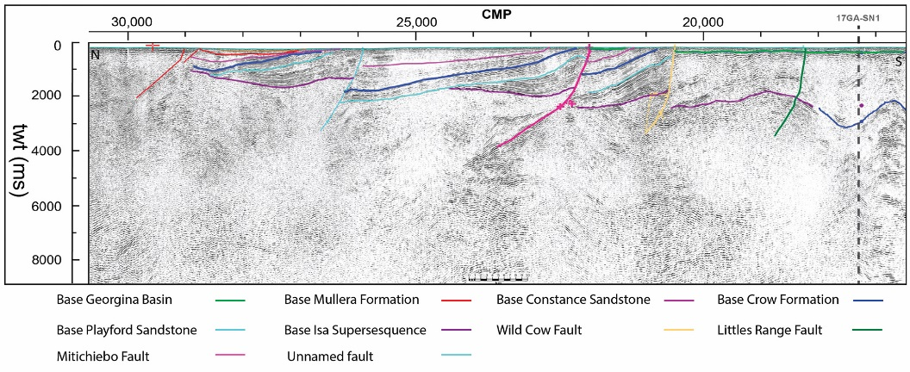
New geoscience for petroleum exploration
NTGS - Resourcing the Territory
GA - Exploring for the Future
New SEEBASE® and stratigraphic correlations across greater McArthur Basin
Unprecedented amount of new geoscience data over South Nicholson Basin and Lawn Hill Platform including regional seismic acquisition
Revisions of Neoproterozoic stratigraphy of Amadeus Basin
2017 South Nicholson seismic

Slide 9
Further Information
Discover and download geoscience information at:
www.minerals.nt.gov.au/ntgs
Regulatory information can be accessed through www.minerals.nt.gov.au and hydraulicfracturing.nt.gov.au
Visit us here at booth 249

