Slide 1

Appraisal of multiple shale plays in the Mesoproterozoic Beetaloo Sub-basin
Dorothy Close
Director Regional Geoscience
NT Geological Survey
NAPE Houston, Feb 2020

Slide 2

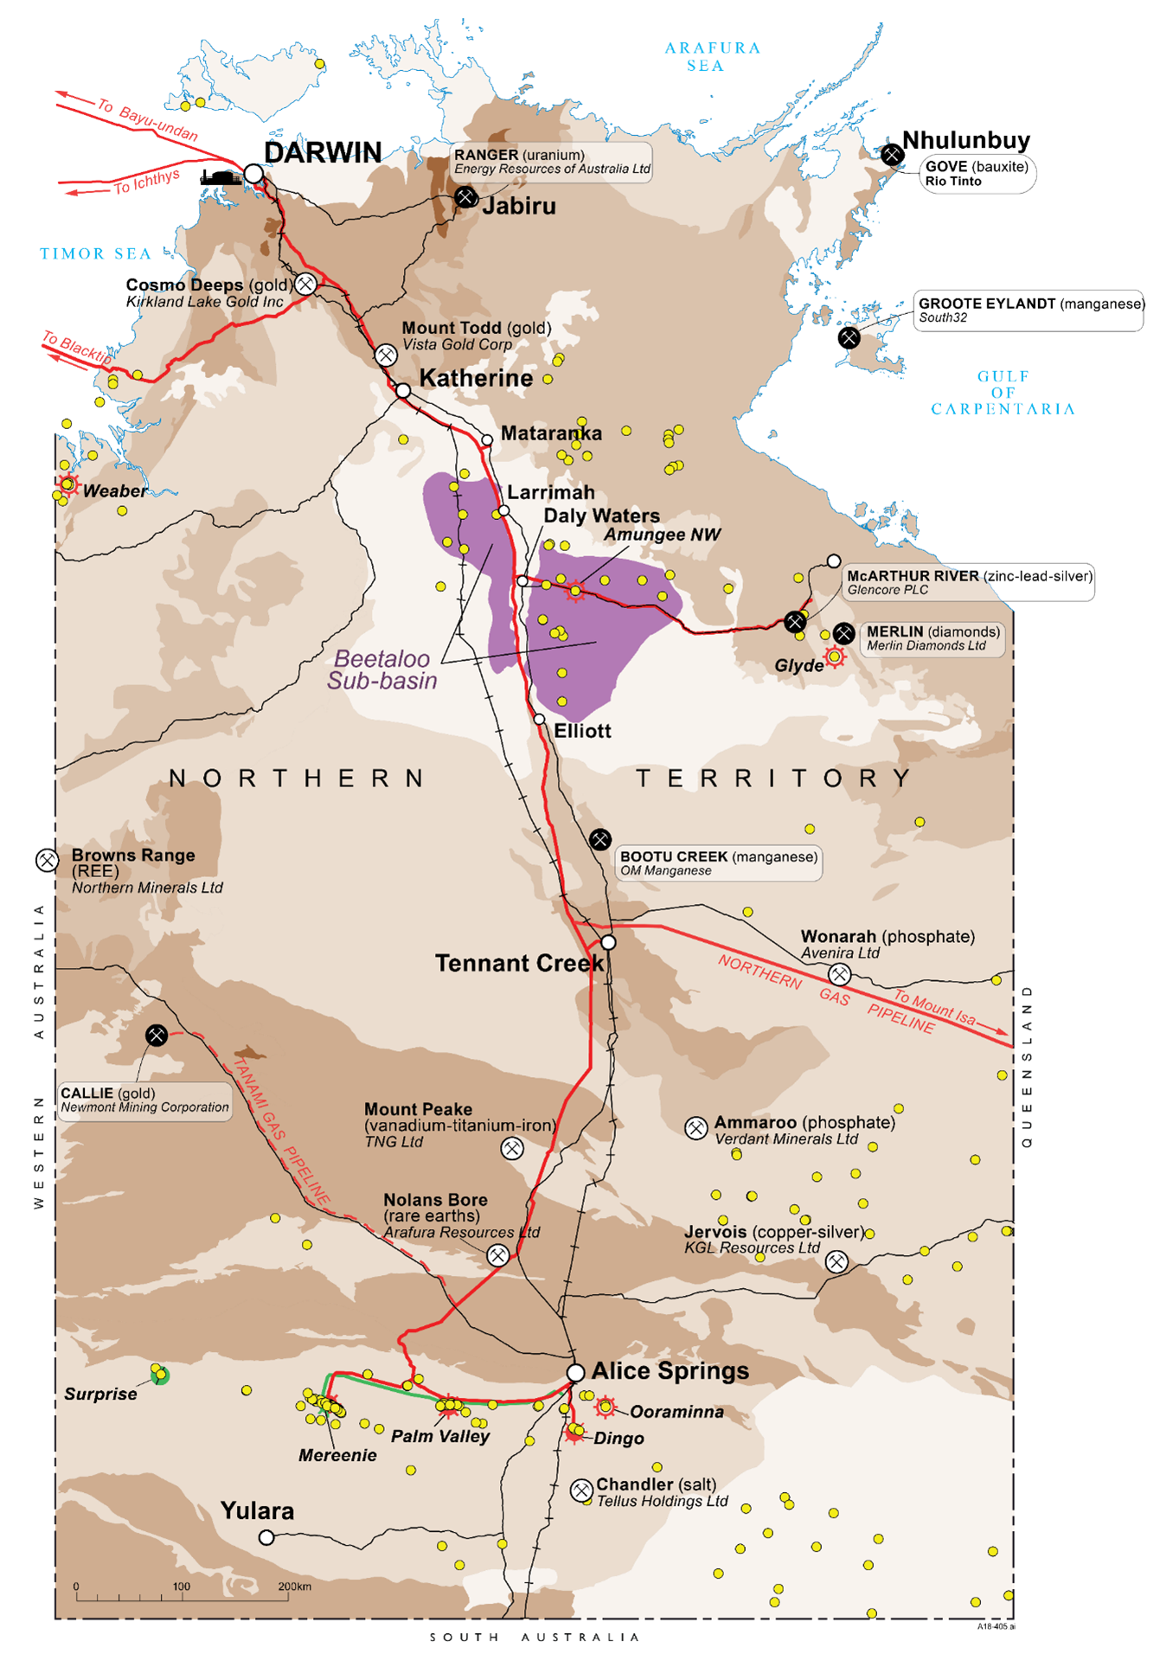
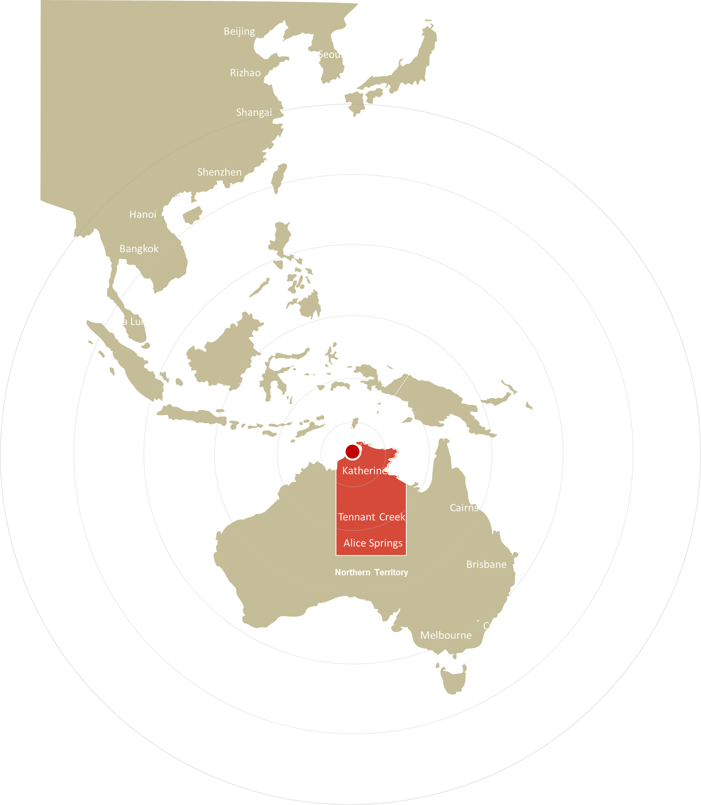
Beetaloo Sub-basin - NT, Australia
Mesoproterozoic sub-basin within highly prospective Paleo-Mesoprot greater McArthur Basin
100’s of Tcf of gas in place
Exploration recommenced in 2019
Laterally extending prospective formations & testing potential for multiple dry gas, wet gas & liquids plays

Slide 3
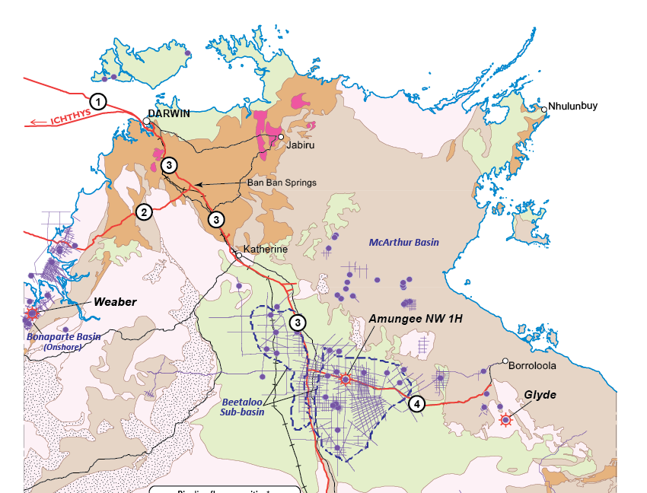
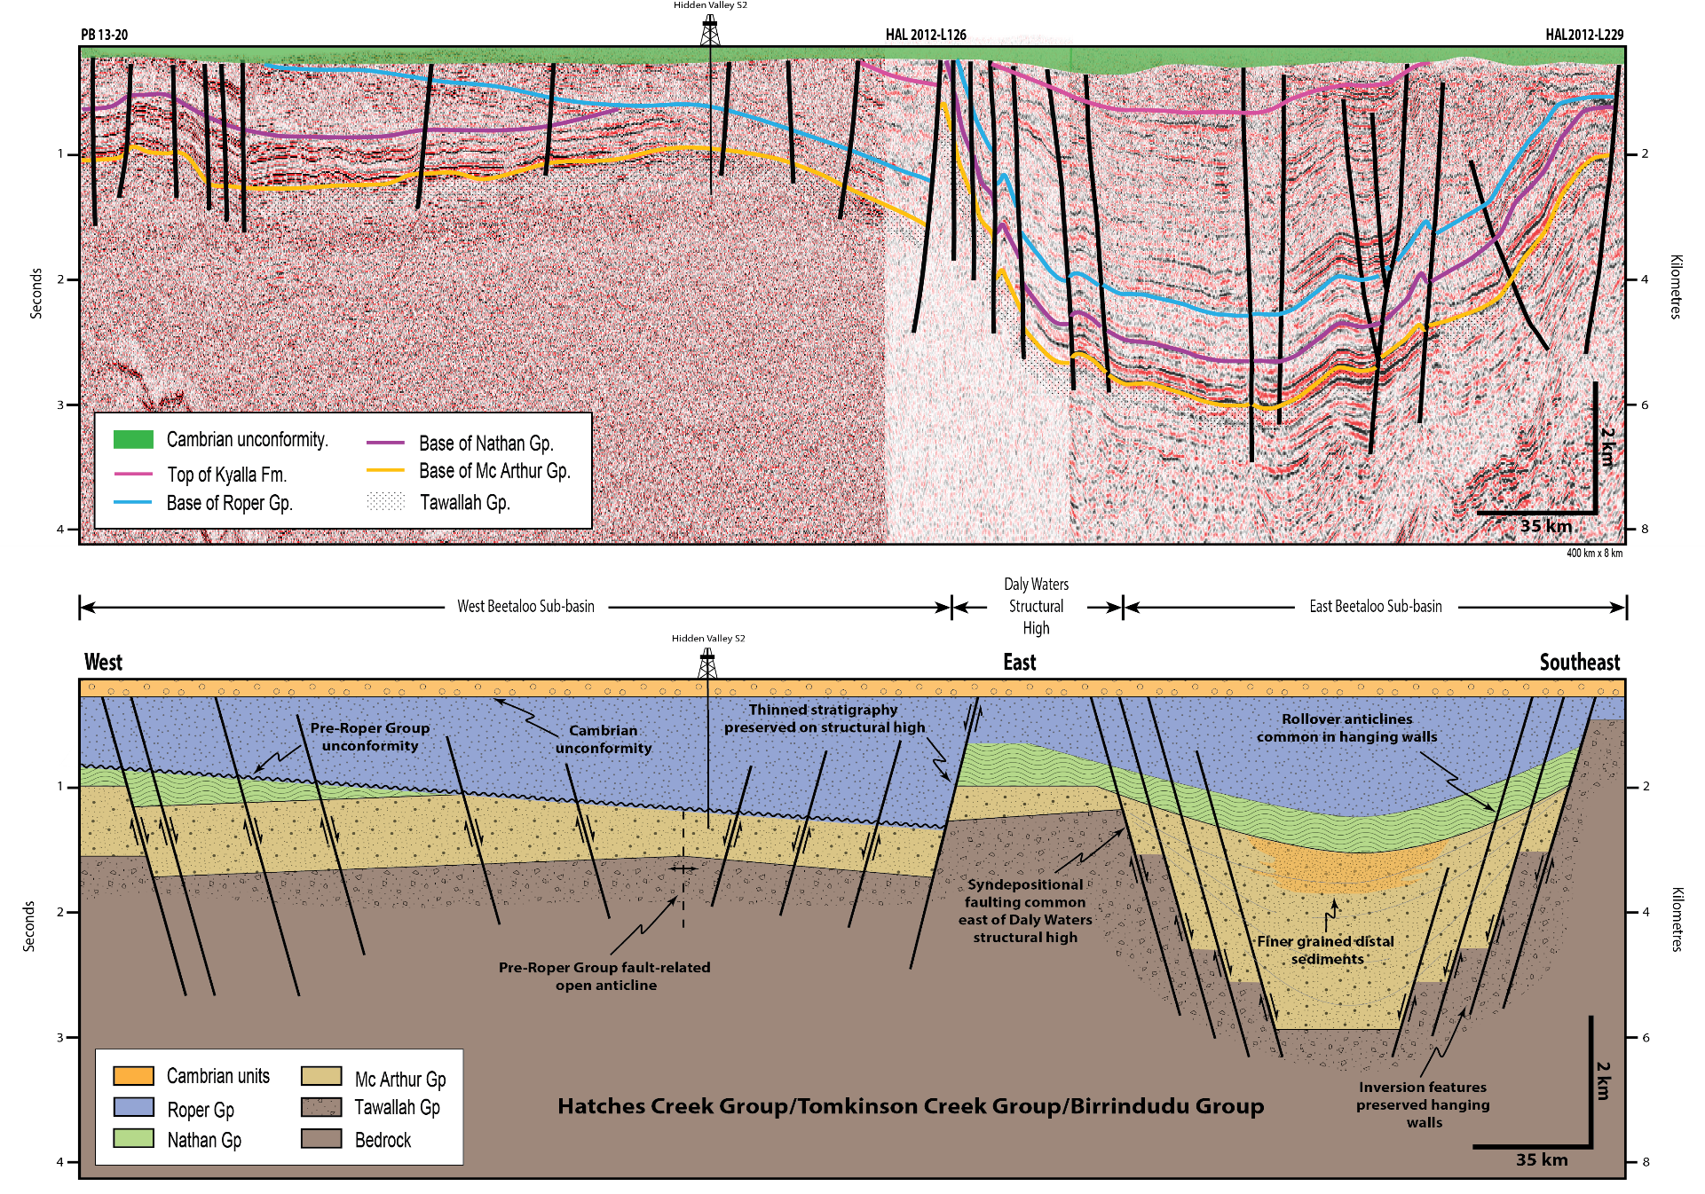
Large scale & multiple play potential
Stacked Paleo-Mesoproterozoic shale gas source rocks
>11 000 sq miles in area
> 300km Mesoprot Roper Group (Velkerri Fm, Kyalla Fm) and Palaeoprot McArthur Group (Barney Crk Fm)
Schemtic E-W composite cross section through Beetaloo Sub-basin

Slide 4
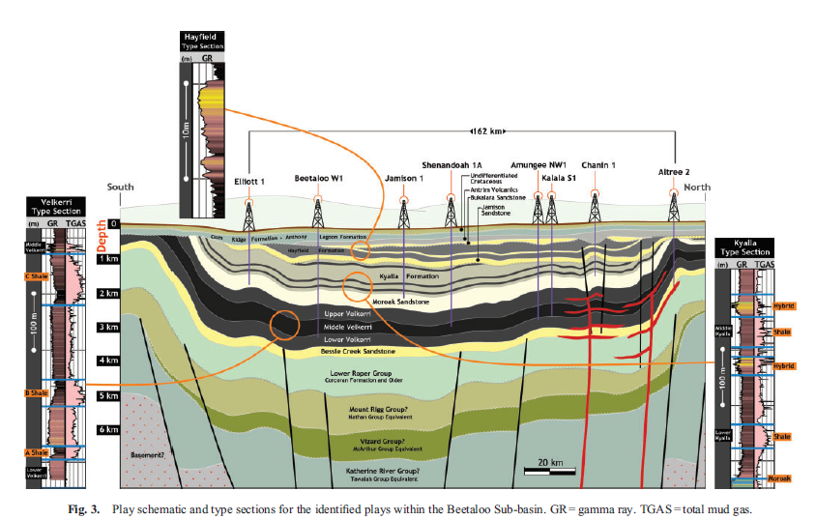
Prospective formations
Velkerri Formation
technically most mature
dry to wet gas cont over > 80 km
3 organic rich shale intervals
ave TOC 3-4%
HFS- extended flow rates of 0.8-1.2 MMscf/d
Amungee NW-1H 2C contingent resource 6.6 TCF
Kyalla Fm
drill tested 2019
ave TOC 1-3%
Côté et al, 2018. The APPEA Journal 2018, 58, 799-804
https: doi.org/10.1071/AJ17040

Slide 5
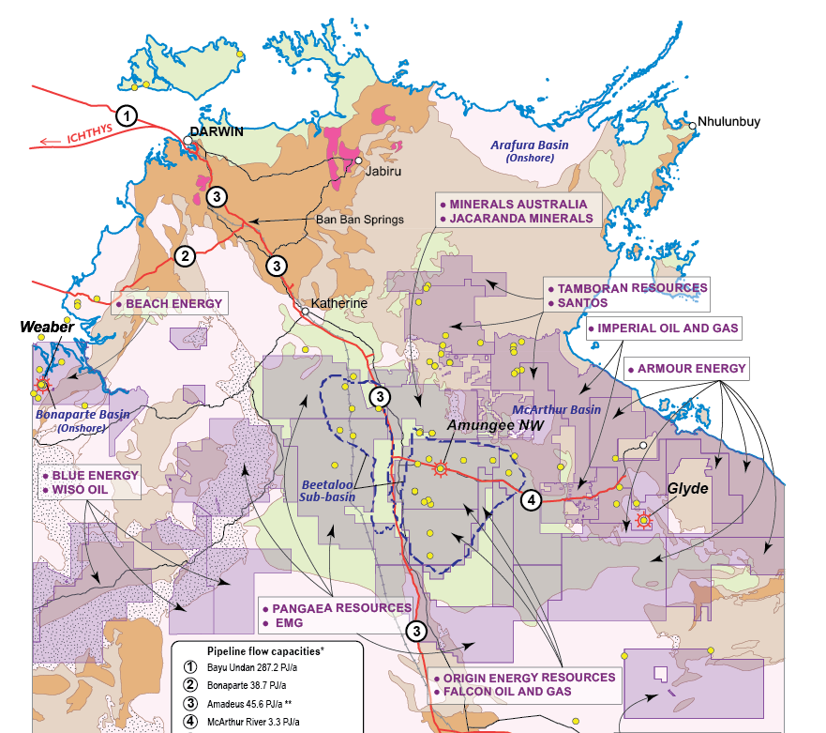
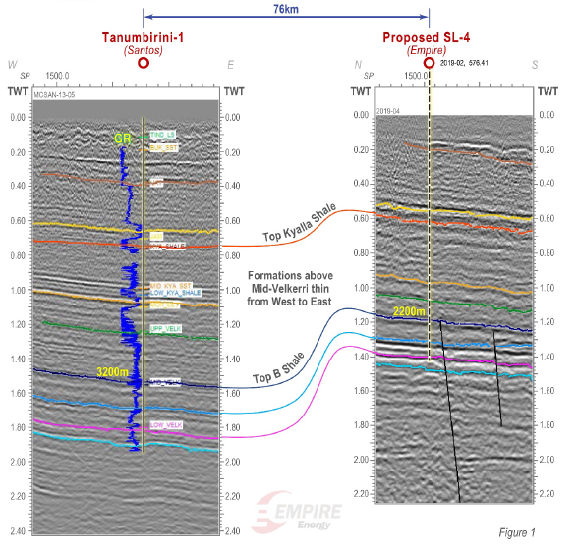
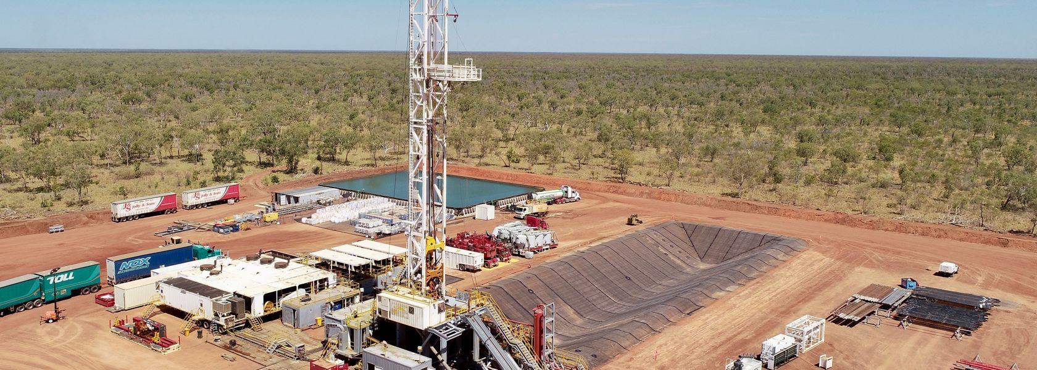
2019 Exploration Beetaloo Sub basin
Seismic acquisition – testing western boundary of Beetaloo Sub-basin (Imperial)
Kyalla 117 N2-1 vertical and lateral - testing multiple plays (Origin)
Tanumbirini re-entry – testing Velkerri Formation members (Santos)

Slide 6
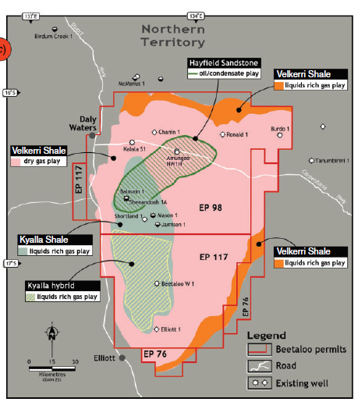
Potential for multiple & stacked plays
Nov 2019 - Kyalla 117 N2-1: 1,895m (> 6000 ft) vertical well - confirmed regionally extensive Kyalla Formation
3 source rock reservoirs within Kyalla Formation – combined thickness 900m (~3000ft)
Elevated gas shows with relatively high C₃,C₄ and C₅ components
Côté et al, 2018. The APPEA Journal 2018, 58, 799-804
https: doi.org/10.1071/AJ17040

Slide 7
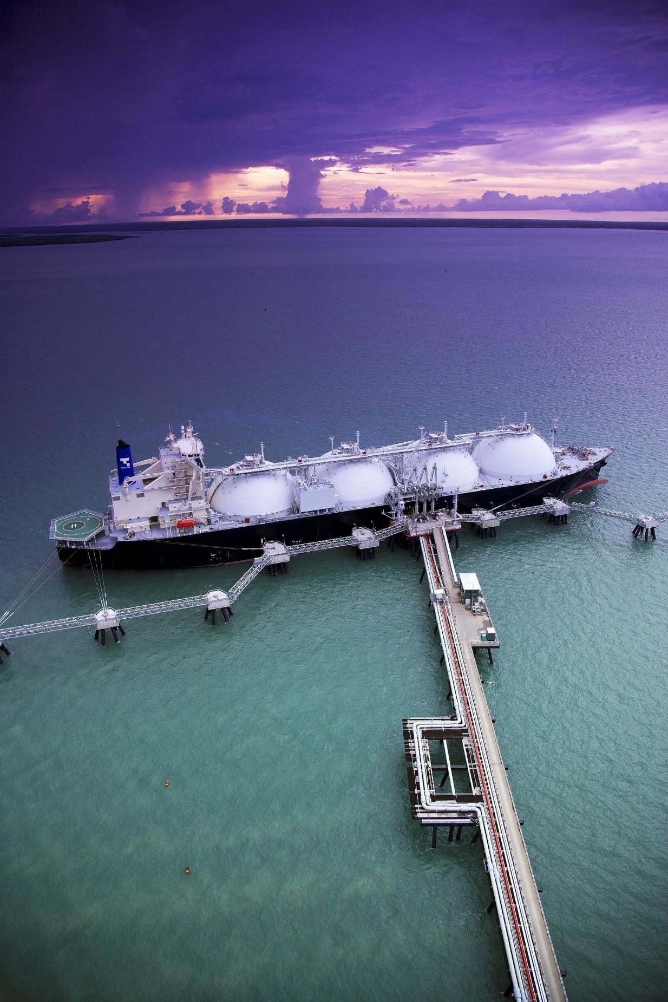
Frontier Beetaloo equivalents
Frontier basins:
South Nicholson Basin ≈ Roper Group
Lawn Hill Platform ≈ McArthur Group
Significant new geoscience data (Australian & NT govt funding) to derisk exploration
New seismic data, source rock geochemistry and planned drilling
Stimulating investment
Santos farm-in to Armour Energy permit applications

Slide 8
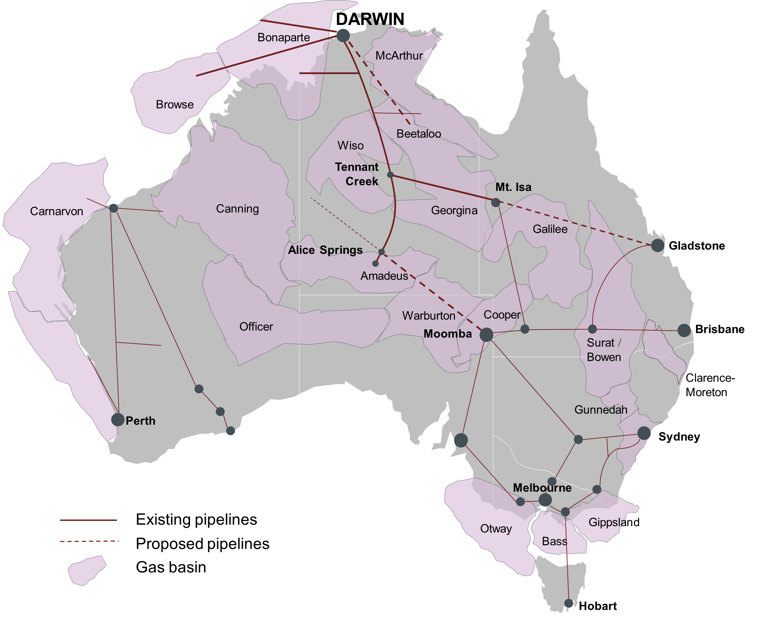
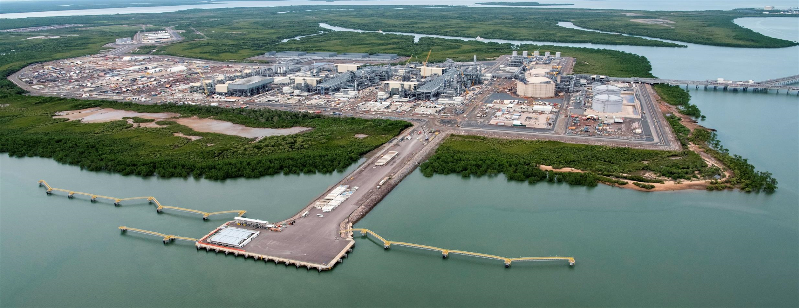
Proximity to markets
Offshore markets
closest LNG hub to SE Asia: Ichthys LNG Project (initial capacity of 8.4 Mtpa LNG) + Darwin LNG (design capacity of 3.7 Mtpa LNG)
Onshore markets
Improved pipeline infrastructure - linked to domestic east coast markets & to major mining operations
Icthys LNG project - Darwin

Slide 9
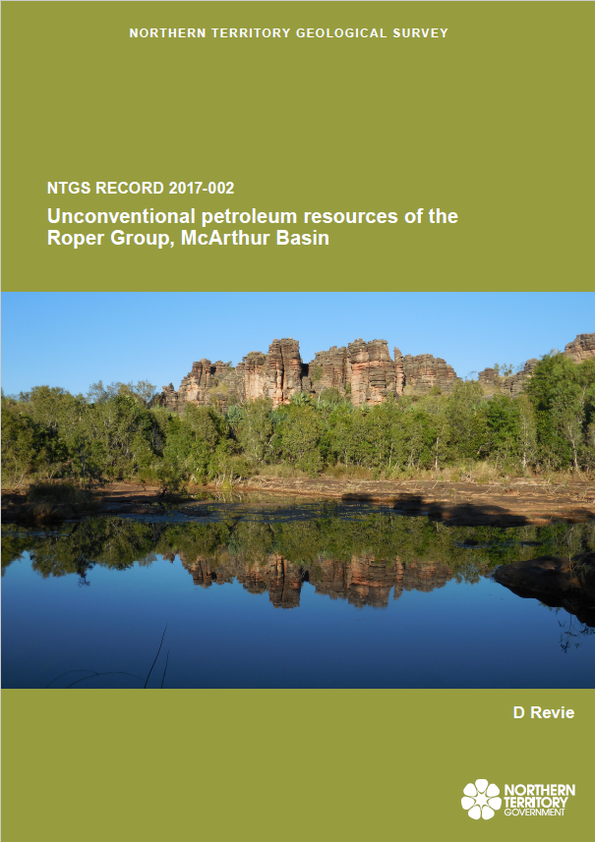
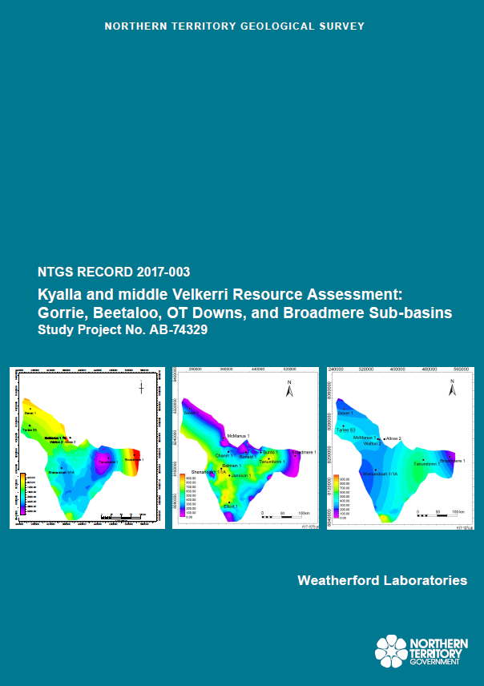
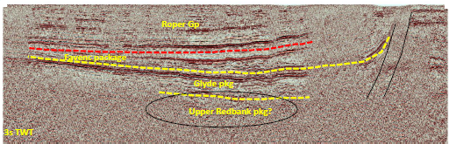
Data freely available
interpretation ready Kingdom seismic project over Beetaloo Sub-basin, Frogtech SEEBASE update over greater McArthur Basin
Discover and download geoscience information at:
www.minerals.nt.gov.au/ntgs
Regulatory information can be accessed through www.minerals.nt.gov.au

Slide 10
Thank you!
Please visit the Australia Petroleum booth in the Expo

