Slide 1
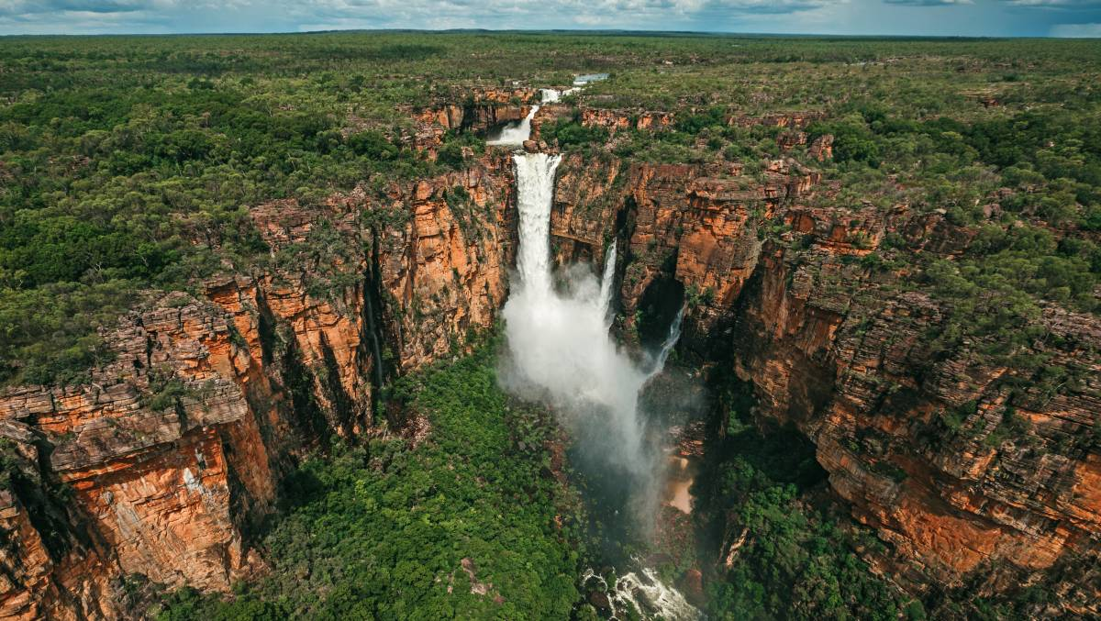
#AustraliaMinerals
Driving discovery in Australia’s Top End through world-class geoscience data
Ian Scrimgeour
Executive Director
Northern Territory Geological Survey

Slide 2
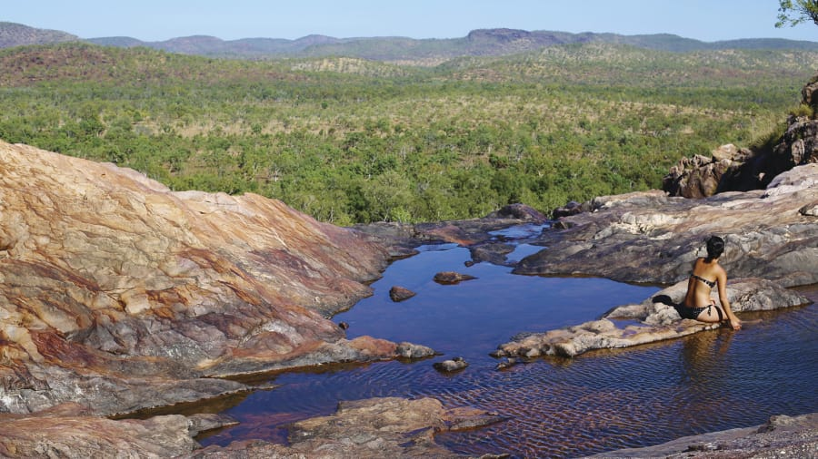

Australia’s Northern Territory
Beijing
Seoul
Shangai
Tokyo
Taipei
Distances from Darwin
Hanoi
Hong Kong
Bangkok
Manila
Seoul | 5574km
Beijing | 6000km
Tokyo | 5400km
Shanghai | 5056km
Taipei | 4288km
Hong Kong | 4250km
Singapore | 3350km
Manila | 3150km
Melbourne | 3150km
Sydney | 3150km
Brisbane | 2850km
Jakarta | 2700km
1000KM
2000KM
3000KM
4000KM
5000KM
6000KM
Kota Kinabalu
Kuala Lumpur
Brunei
Singapore
Jakarta
Bali
Dili
Port Moresby
Darwin
Northern Territory
Cairns
Brisbane
Perth
Sydney
Adelaide
Melbourne
Canberra
Hobart

Slide 3
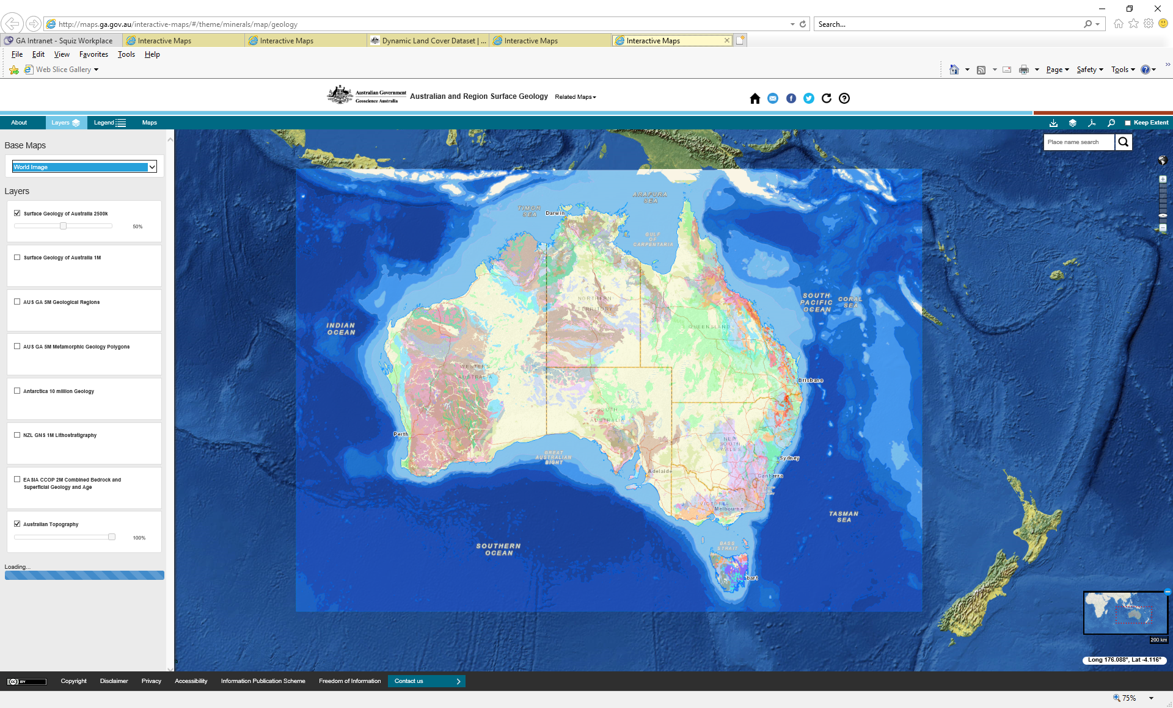
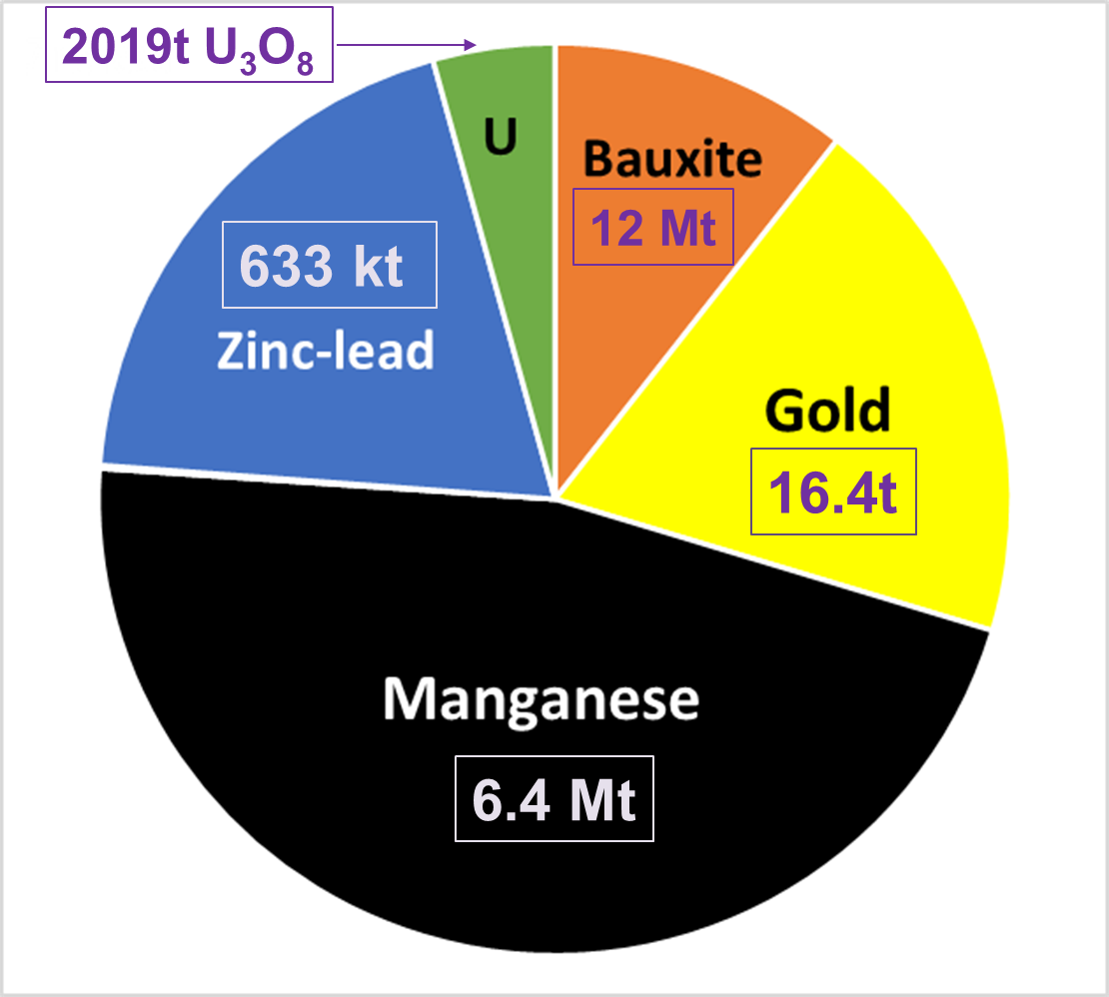
Australia’s Northern Territory
Mineral production 2018/19
Northern Territory

Slide 4
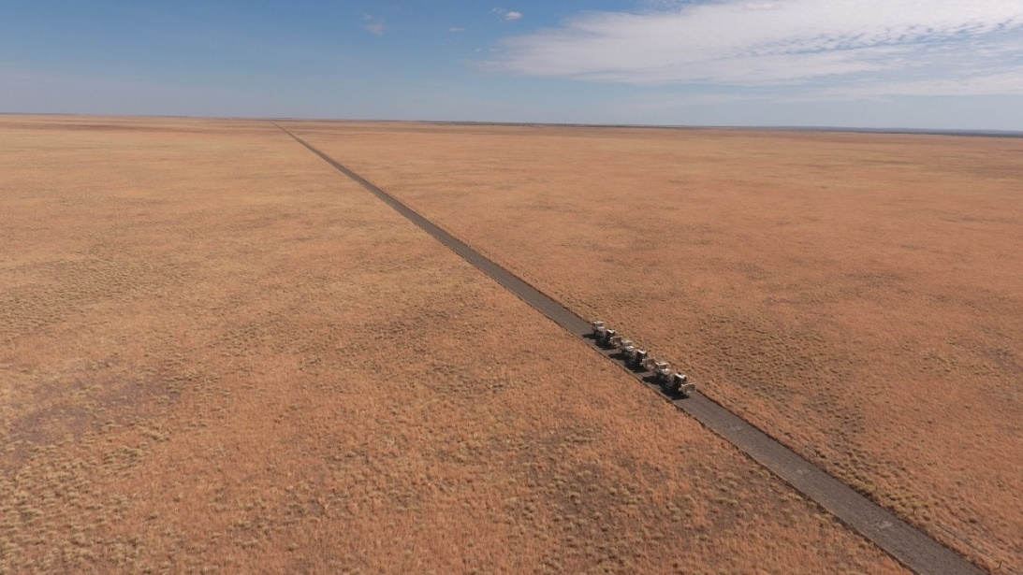
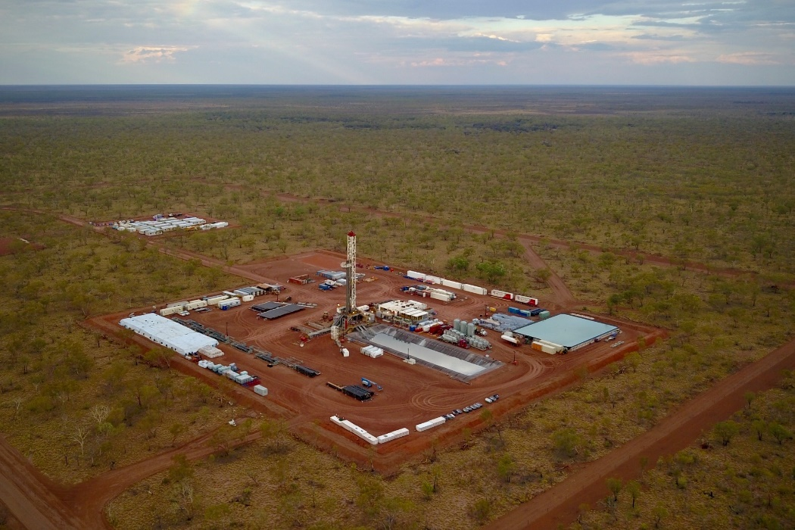
The challenge
Vast areas of cover, including Phanerozoic sedimentary basins
Most of Australia is not mature from an exploration perspective!
1.3 million km² (size of Quebec)
250,000 people
20 survey geologists

Slide 5


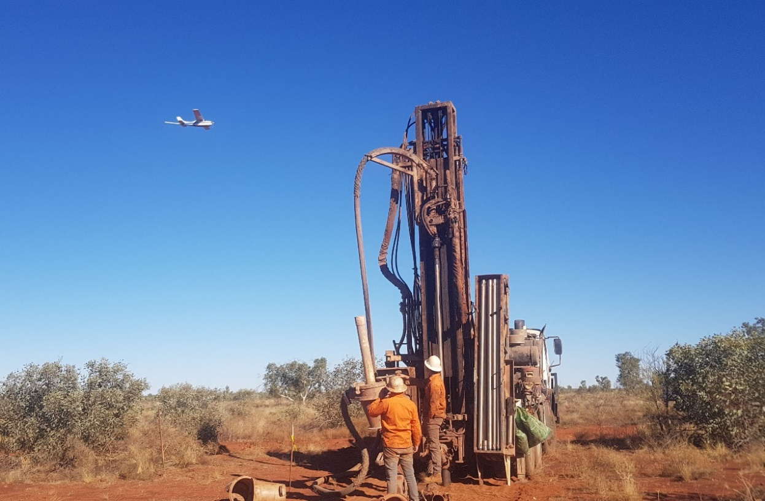
Resourcing the Territory initiative
4 year (2018-2022), $26 million NT Government initiative to grow the exploration sector
resourcingtheterritory.nt.gov.au
Tanami airborne survey: Photo courtesy of Prodigy Gold
Supporting industry innovation through grants for greenfields exploration
Upgrading the Territory’s coverage of geophysical data
Unlocking the resource potential of the Barkly and Gulf regions
Stimulating greenfields exploration in central Australia
Promoting the Territory’s resource potential and investment opportunities; and
Making exploration and geoscience data more accessible

Slide 6



Commonwealth-state/NT-research-industry collaboration
A competitive advantage for Australia
Very strong Commonwealth-state relationships
High quality researchers
Engaged exploration sector

Slide 7
T-ISA (Tennant Creek-Mt Isa) Project
Why? Covered frontier between two known endowed mineral provinces
GA acquired new data to map geology and mineral systems from lithospheric roots to the near surface
  Surface geochemistry (soil, hydro)
  Cover thickness models
  Airborne electromagnetic data (AusAEM)
  Solid geology maps
  U-Pb geochronology
  Isotopic mapping
  Reflection seismic
  Long-period magnetotellurics (AusLAMP)
  Seismic velocity (AusARRAY)
NTGS co-invested, acquired gravity, managed land access, undertook field mapping, supplied data and expertise
TENNANT CREEK
MT ISA

Slide 8
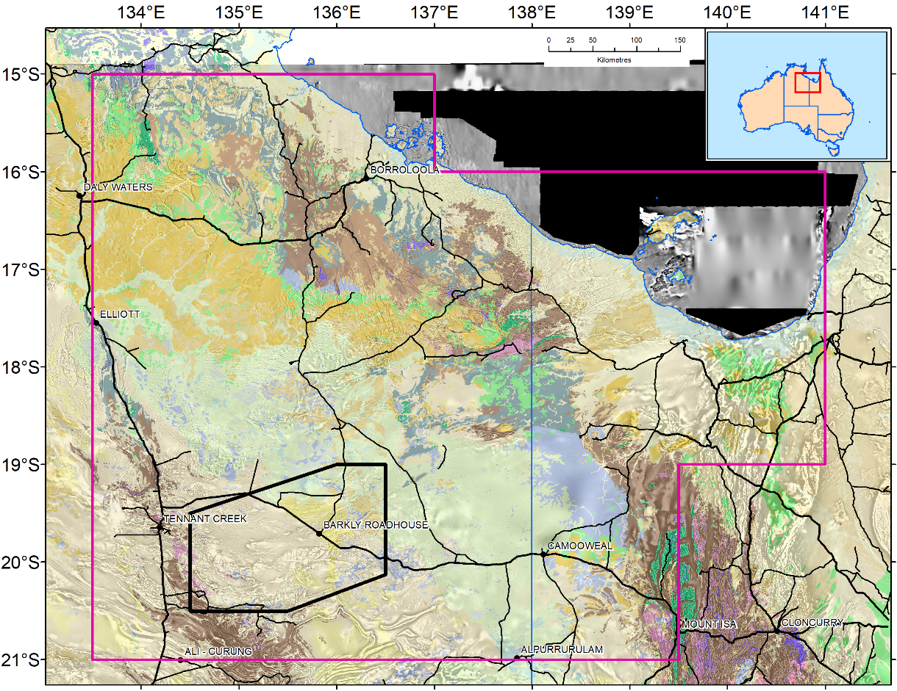

East Tennant region
Chosen for more detailed work on the basis of:
Large-scale architecture
AusLAMP conductivity models
Modelled Fe-oxide alteration
Modelled mineral potential
Accessible basement depths
Low historic exploration levels
McARTHUR RIVER
NT
Qld
TENNANT CREEK
150 km
MT ISA

Slide 9
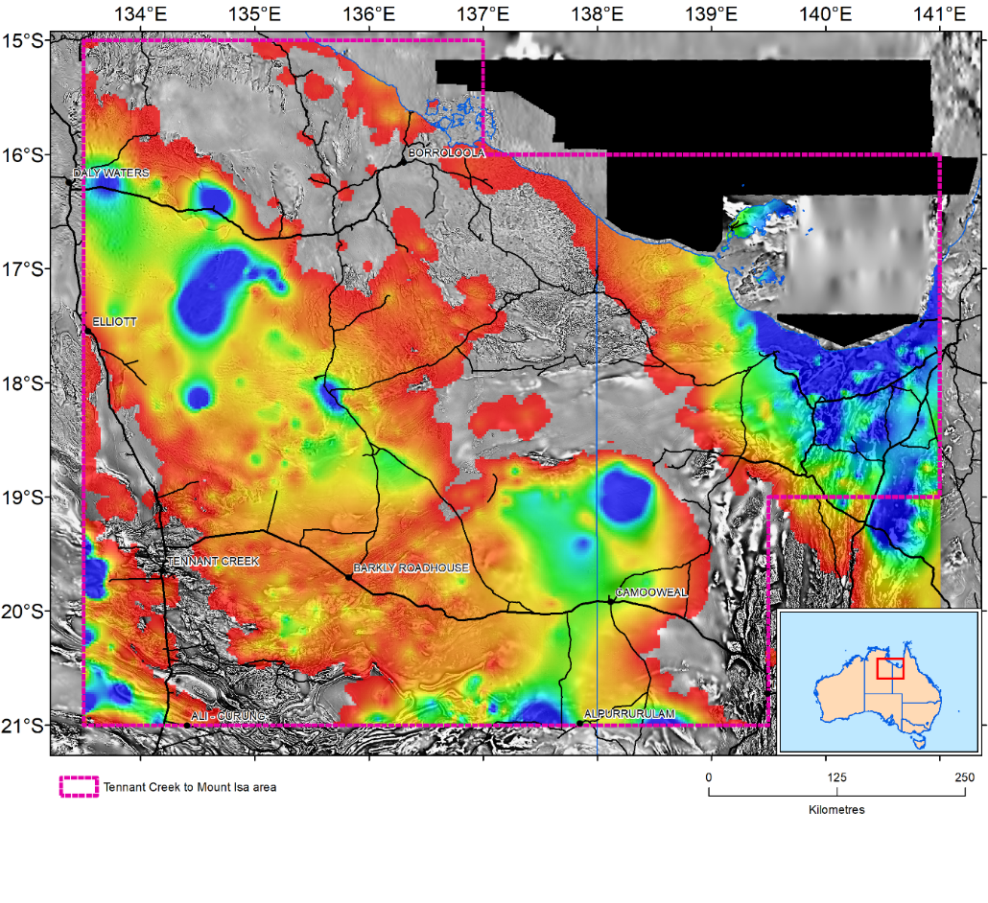
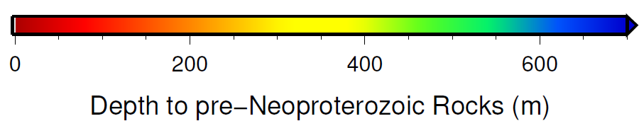
Pre-Neoproterozoic basement depth
East Tennant region
Depth to prospective basement largely in the range 100-300m
Geochronology on legacy drillcore suggests 1870-1850 Ma basement
Legacy drilling intersected hematite alteration

Slide 10
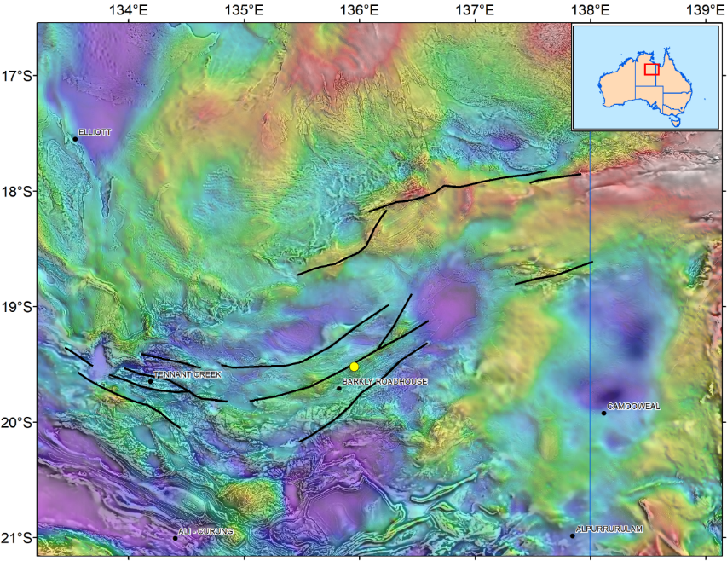
Pre-Neoproterozoic basement depth
East Tennant region
Depth to prospective basement largely in the range 100-300m
Geochronology on legacy drillcore suggests 1870-1850 Ma basement
Legacy drilling intersected hematite alteration
WNW-ESE trending regional-scale structures

Slide 11
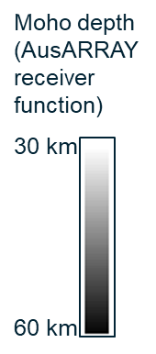
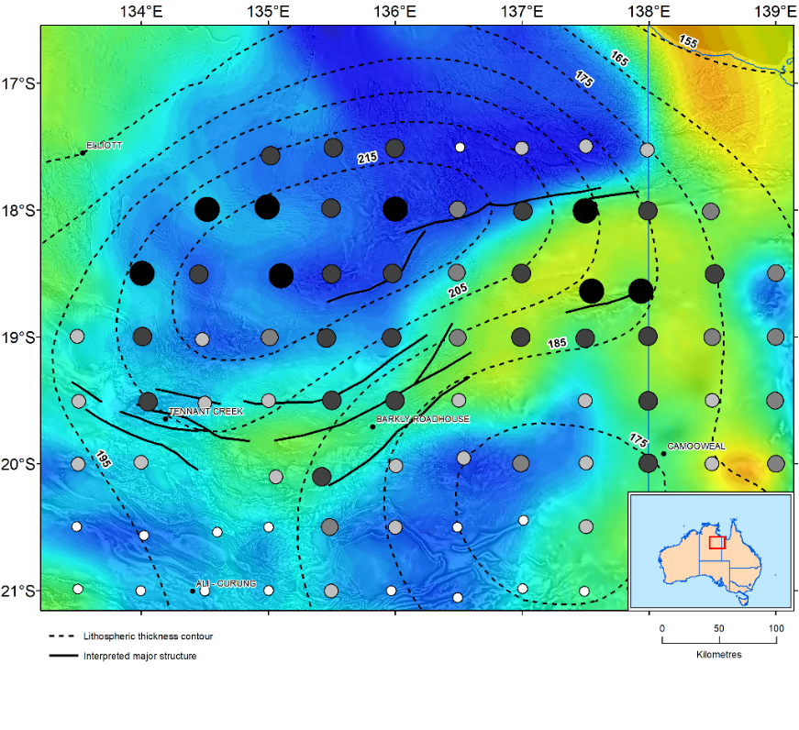
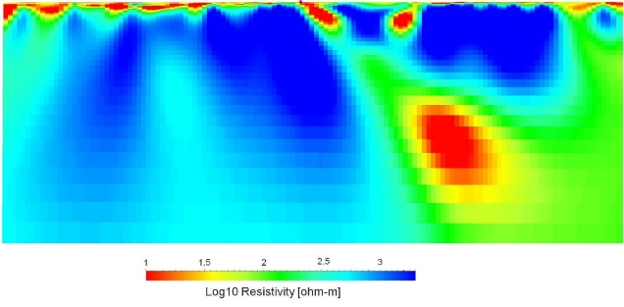
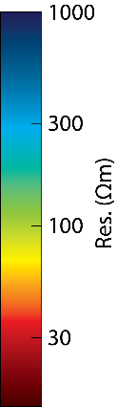
Thickness of crust and lithosphere; deep conductivity
East Tennant region
Evidence for offsets in lithospheric and Moho depth, associated with gravity ridge and high conductivity zone in MT
PRELIMINARY DATA ONLY
(Subject to change)
Lithosphere-asthenosphere depth contours (km) from Czarnota et al. (2019)

Slide 12
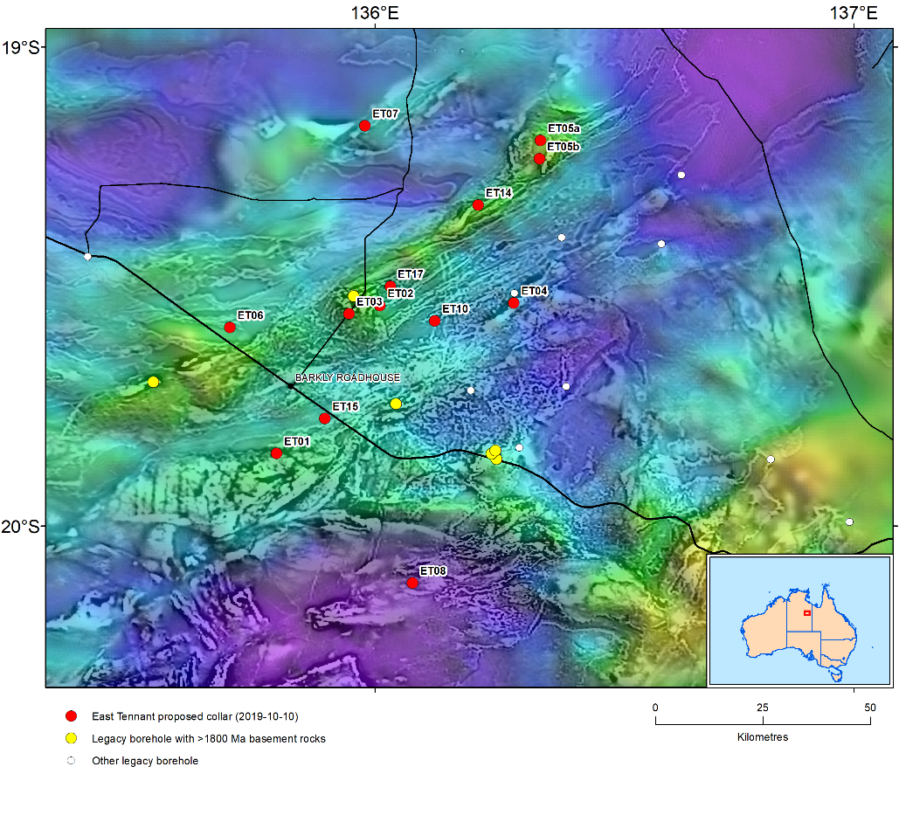
East Tennant NDI drilling program
Part of MinEx CRC – major national research collaboration including National Drilling Initiative
12 proposed holes being permitted
To understand the regional geological framework and mineral systems potential, and ultimately attract explorers
50 km

Slide 13
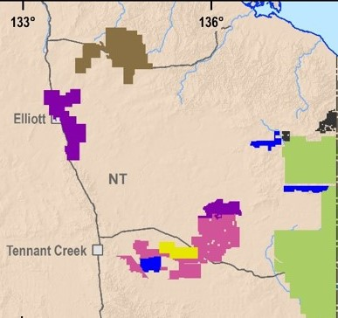
East Tennant region
Substantial takeup of exploration tenure on basis of new pre-competitive data
No applications allowed area in East Tennant area lifted in October
16 competing applications from six companies
McARTHUR RIVER
NT
Qld
TENNANT CREEK
150 km
MT ISA

Slide 14
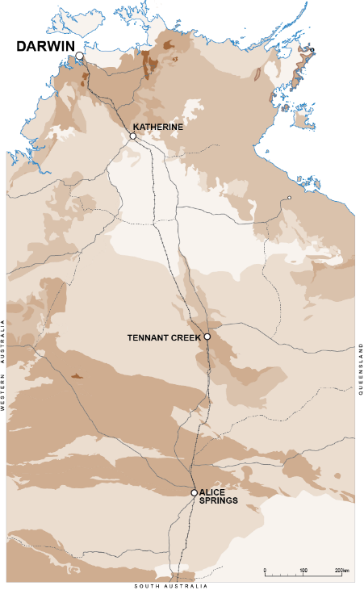
CSIRO collaboration to support base metal exploration in the McArthur Basin
tectonostratigraphic evolution of the middle McArthur Group
4D redox evolution of Barney Creek Formation
Zn isotopic and mineralogical characterization of the HYC deposit
geophysical interpretation and modelling of basin architecture
numerical fluid flow modelling
reprocessing, assessment and interpretation of industry AEM

Slide 15
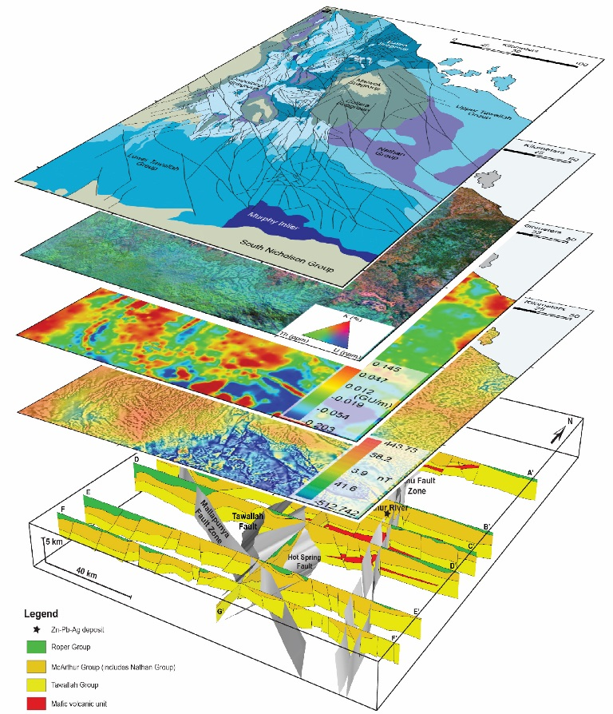
CSIRO collaboration to support base metal exploration in the McArthur Basin
tectonostratigraphic evolution of the middle McArthur Group
4D redox evolution of Barney Creek Formation
Zn isotopic and mineralogical characterization of the HYC deposit
geophysical interpretation and modelling of basin architecture
numerical fluid flow modelling
reprocessing, assessment and interpretation of industry AEM

Slide 16
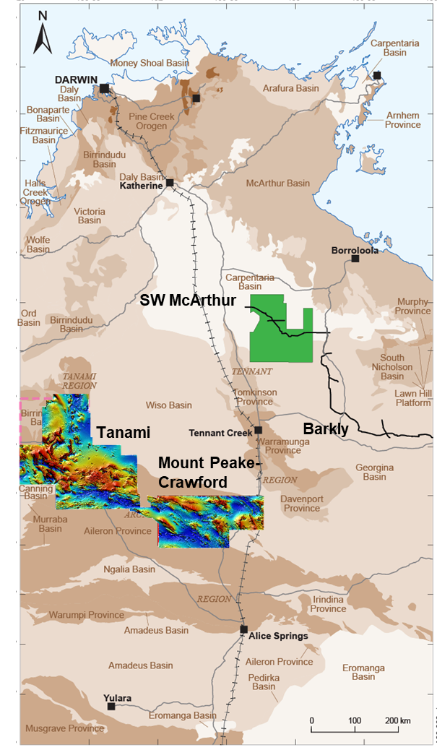
Enhancing geophysical coverage
400m line spacing magnetic-radiometric data and 4 km spaced gravity data as a minimum
200m line spacing over basement geology; encouraging 100m infill from industry
2km gravity over key mineral provinces and structurally complex basins, encouraging 1 km infill from industry

Slide 17
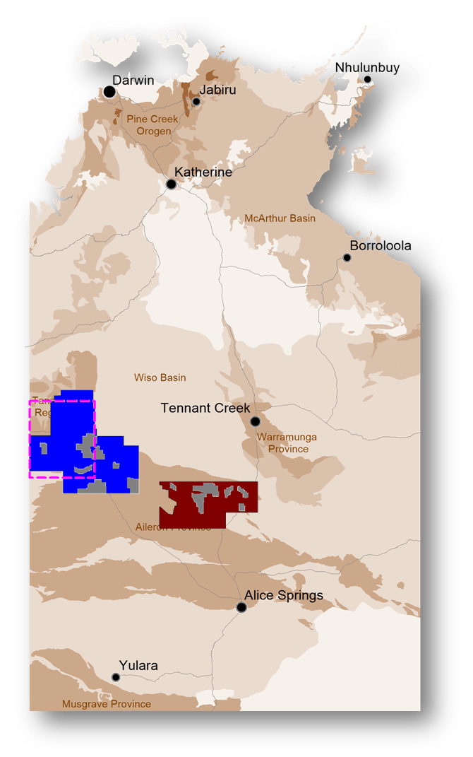
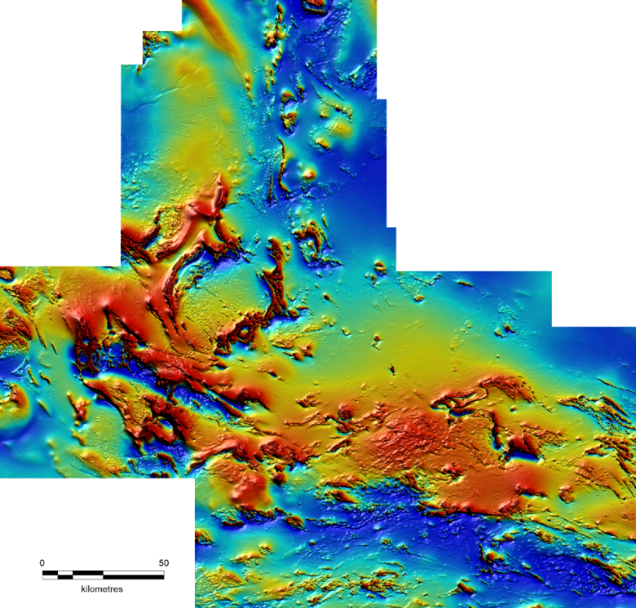
NTGS Tanami Magnetic-Radiometric Survey
Previous coverage was 500m line spacing pre-GPS
Complete coverage of the NT’s premier gold province
100-200m line spacing; 42,000 km²
Released late 2019
Industry infill to 100 m by four companies
Gravity in 2020

Slide 18

Involving industry in pre-competitive geoscience
NTGS do this through
Grants to co-fund greenfields drilling (mainly diamond core)
Grants to co-fund regional geophysics
Grants to co-fund innovative geophysics
Partnering on Government-led geophysical surveys
Working on collaborative research projects
Maximising the delivery and accessibility of open-file industry datasets

Slide 19
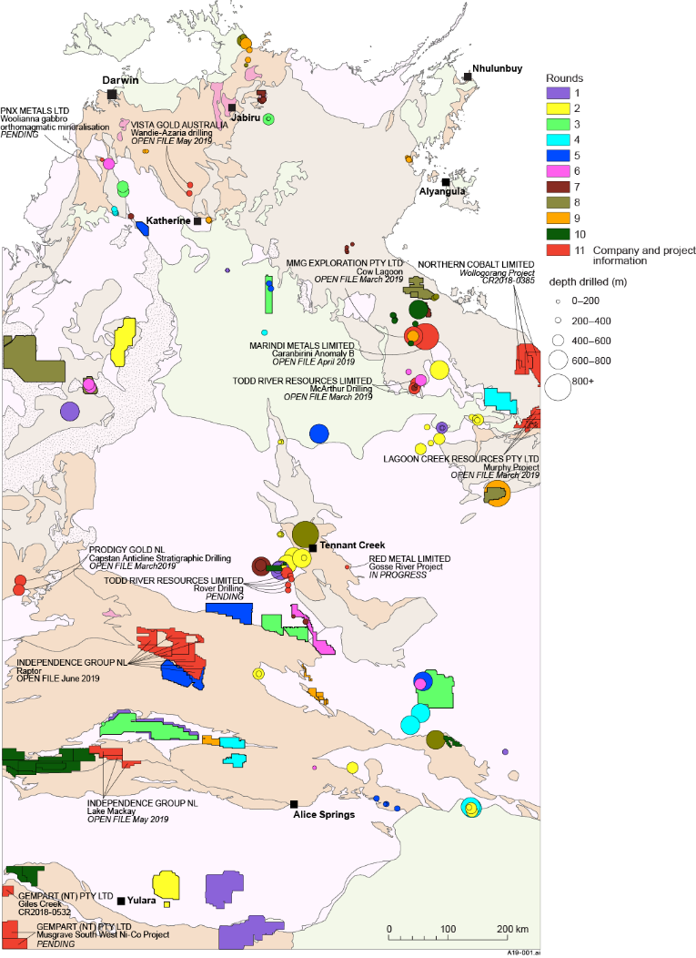
Power of co-funded drilling and geophysics
Since 2008:
  67 Drilling projects
  148 holes: >51,000 m drilled (42,760m diamond core)
  42 Geophysics projects
  ~71,000 ground gravity stations
  ~148,000 line km of airborne magnetic
  and radiometric surveys
  ~31,000 line km of airborne EM surveys
  ~400 audio magnetotelluric stations
  ~82 line km of seismic
  ~1,400 line km of SAM surveys
  ~18 km of passive seismic

Slide 20
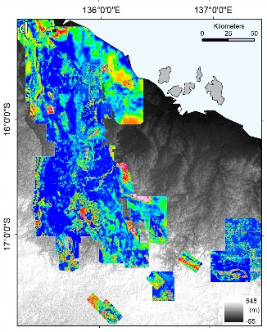
Improving accessibility of industry datasets
Capture of NT-wide exploration drilling and geochemistry
Compilation of geophysical data into seamless grids and datasets
3D atlases of mineral fields (with University of Queensland)
Merged historical industry AEM datsets, McArthur Basin

Slide 21
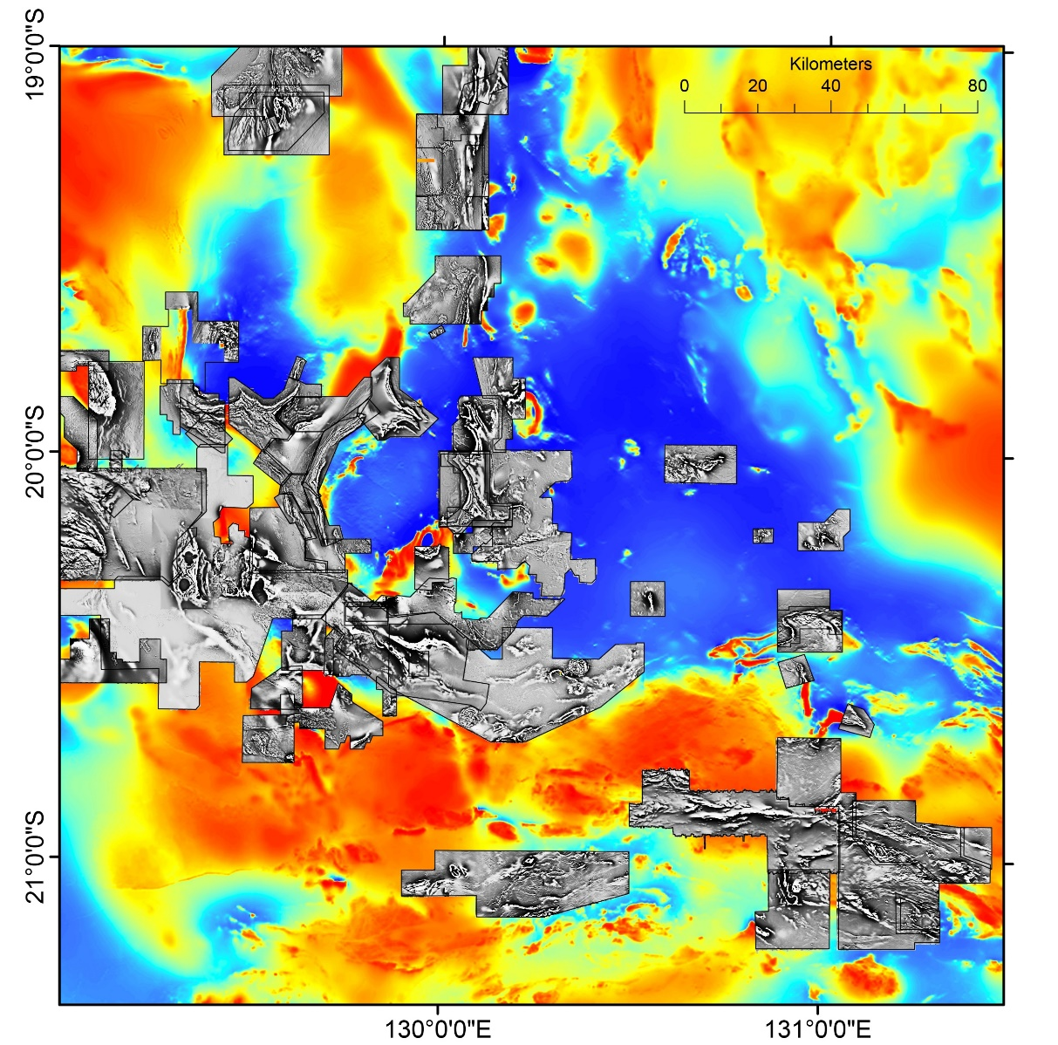
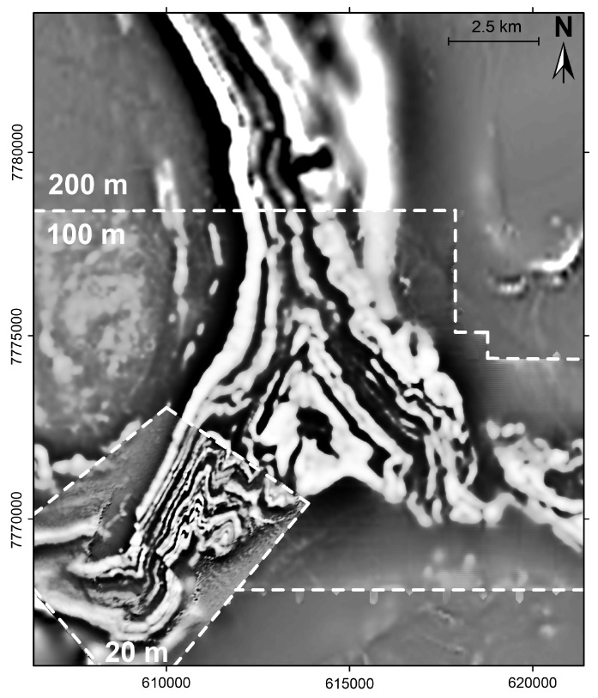
Maximising the value of industry data
CSIRO-NTGS collaboration in the Tanami gold province

Slide 22
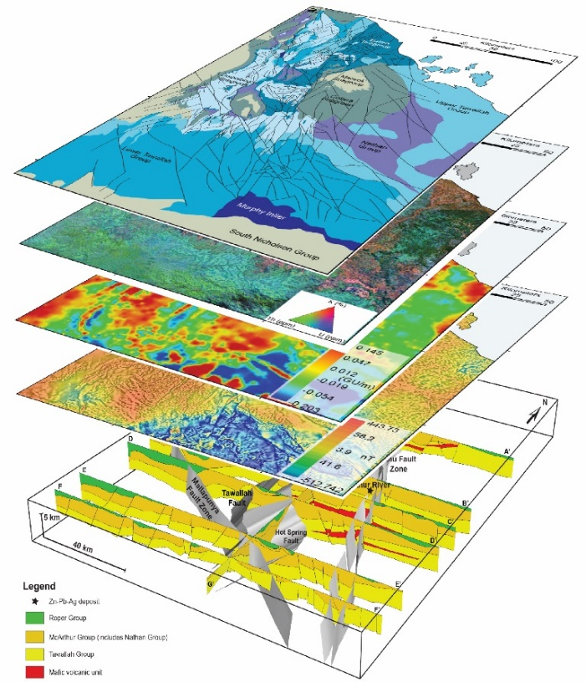
Summary
Collaboration between the Australian state/NT and Commonwealth governments, the research sector and industry is opening up new undercover mineral provinces in large, underexplored jurisdictions like the NT
Taking a multi-scale, multi-disciplinary approach to terrane-scale problems
Bringing industry into pre-competitive programs wherever possible adds huge value
Maximising the discovery and utility of industry data
resourcingtheterritory.nt.gov.au

